Slide 1

About FHPL Mobile Sparrow
FHPL is the first TPA to launch the Mobile App “SPARROW” in INDIA.
The Mobile App “Sparrow” is an internet application designed to run on smartphones.
The “SPARROW” app is used for Corporate Employees/Individual Policy Holders.
This app enables employees to utilize the hospitalization by showing the E-Card available on Smart Mobile.
Respond quickly to any pending claim (Complete Claim Status on finger tips).
Claim shows along with the settlement details.
Member can easily find FHPL Network Hospitals

Slide 2

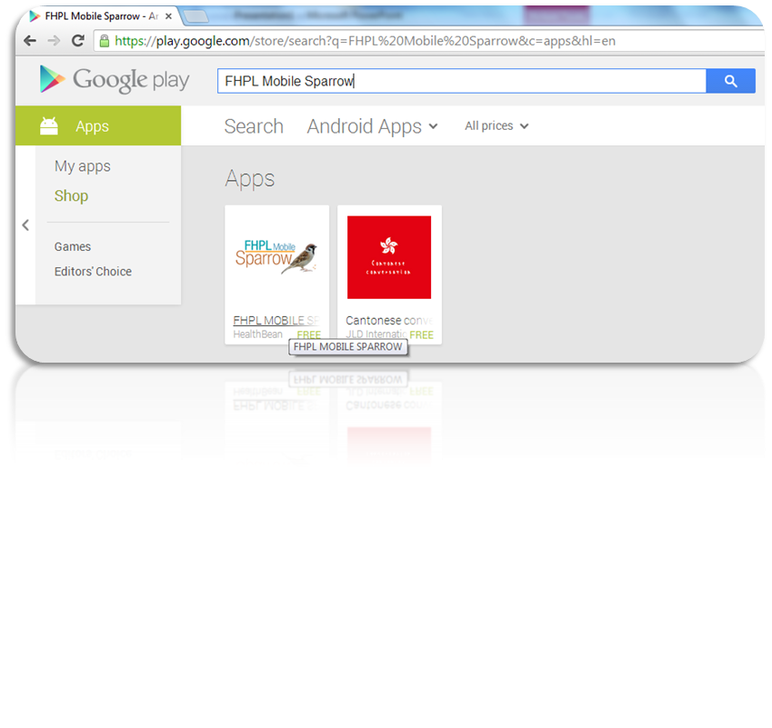
How to Download - Mobile Sparrow
Download Android apps
You can download Android apps and digital content to your device using the Google Play Store app or your computer (play.google.com).
Click on the link: https://play.google.com/store/apps/details?id=net.fhpl
Category: Medical
You can download content on Google Play using your device's Internet connection, you don’t need to connect your device to your computer. As long as you have a good Wi-Fi or mobile data (3G/4G) connection on your device, your apps will start downloading immediately.
You can search in Google Play Store for FHPL Mobile Sparrow

Slide 3
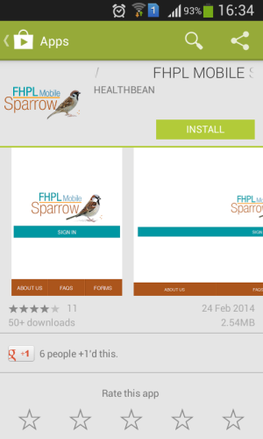
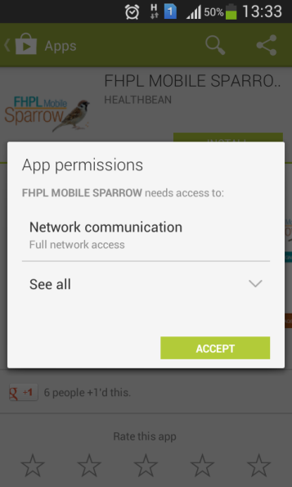
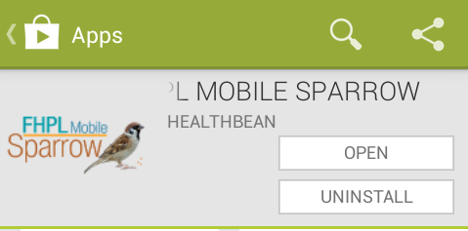
How to Install – Mobile Sparrow
After download, open the app on your mobile & start Installation
1
Click on the INSTALL button:
2
Click on the ACCEPT button:
3
Click on the OPEN button:
Installation procedure for Android App: (any Android App)
https://support.google.com/googleplay/answer/113409?hl=en

Slide 4

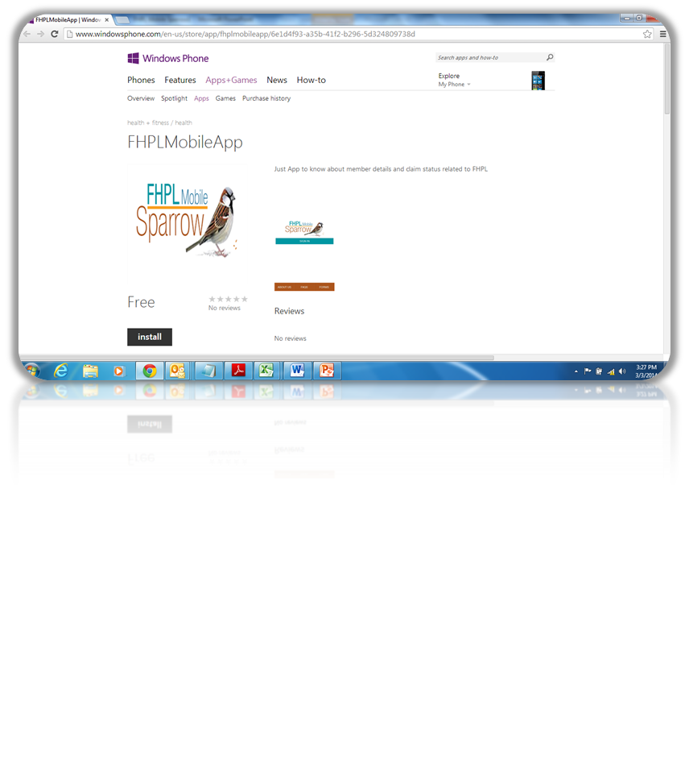
How to Download - Mobile Sparrow
Download Windows apps
You can download the Sparrow App by clicking the below link.
Link: http://www.windowsphone.com/s?appid=6e1d4f93-a35b-41f2-b296-5d324809738d
Category: health + fitness / health
You can download content on Windows Mobile App Store using your device's Internet connection, you don’t need to connect your device to your computer. As long as you have a good Wi-Fi or mobile data (3G/4G) connection on your device, your apps will start downloading immediately.

Slide 5
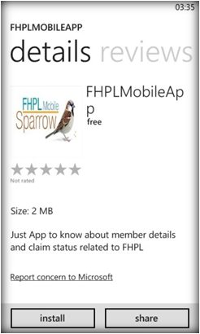
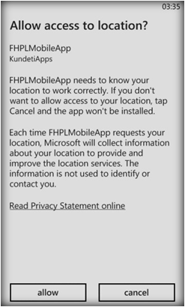
How to Install – Mobile Sparrow
After download, open the app on your mobile & start Installation
1
Click the install button:
2
Click the allow button:
3
Once Sparrow is installed, click the application to open and start
using the app

Slide 6
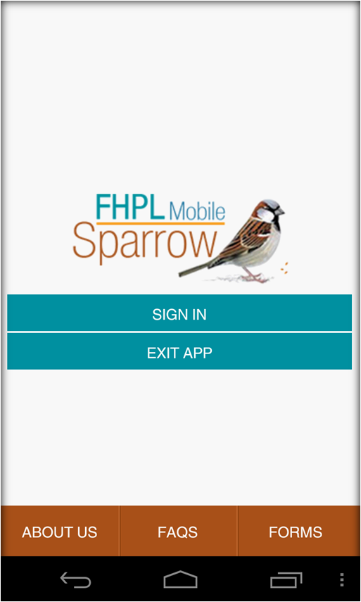
Broad Features - Mobile Sparrow
SIGN-IN Screen
When a member opens the Sparrow App for first time, it opens a SIGN-IN screen to log into the application.
In this screen, member can view basic information like
About Us: Shows the details of FHPL TPA
FAQ: Frequently Asked Questions by Members and respective answers
FORMS: Member can view or download required FORMS

Slide 7
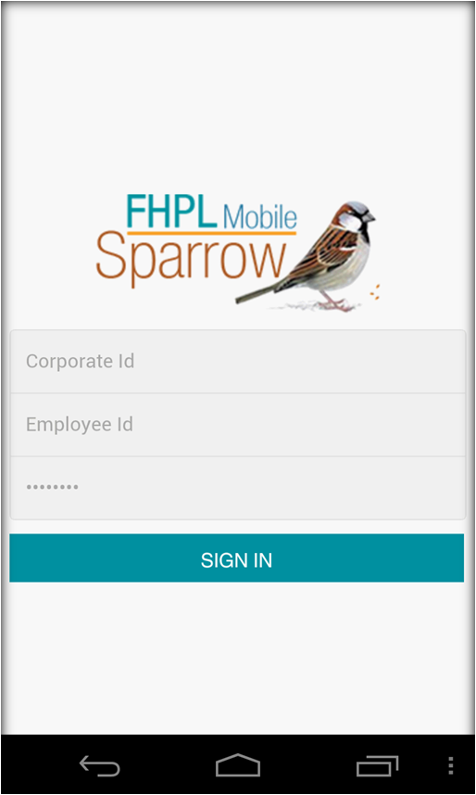
Broad Features - Mobile Sparrow
LOGIN Screen
When a member clicks on SIGN-IN button, a login screen appears.
In this screen, member enters with login credentials and access the app.
Corporate ID:
→ is a mandatory field
→ every employee should remember this field to access the app; details will be shared by HR
Employee ID:
→ is a mandatory field
→ use the same ID which is used in FHPL e-Card module
Password:
→ is a mandatory field
→ use the same password which is used in FHPL e-Card module

Slide 8
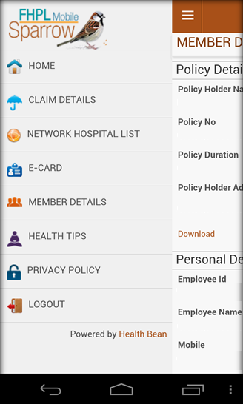
Broad Features - Mobile Sparrow
MENU Screen
When a member clicks on MENU button, below are the features available to access.
HOME:
To navigate to HOME page from any screen
CLAIM DETAILS:
The employee’s self or family level hospitalization claim details are displayed
NETWORK HOSPITAL LIST:
App allows to display the list of FHPL Network Hospitals
E-CARD:
Employee’s self or family level e-Cards are displayed for any hospitalization purpose
MEMBER DETAILS:
Employee can view self or family level details
CLAIM INTIMATION:
Member can intimate a claim thru mobile app for any hospitalization

Slide 9
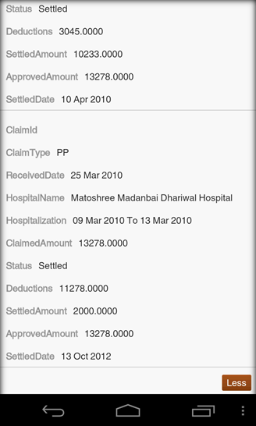
Broad Features - Mobile Sparrow
CLAIM DETAILS Screen
When a member clicks on CLAIM DETAILS link, system provides required claim details like:
Hospitalization Details
Claimed Amount
Claim Status
→ Approved
→Settled
→ Information Required
→ Rejected etc…

Slide 10
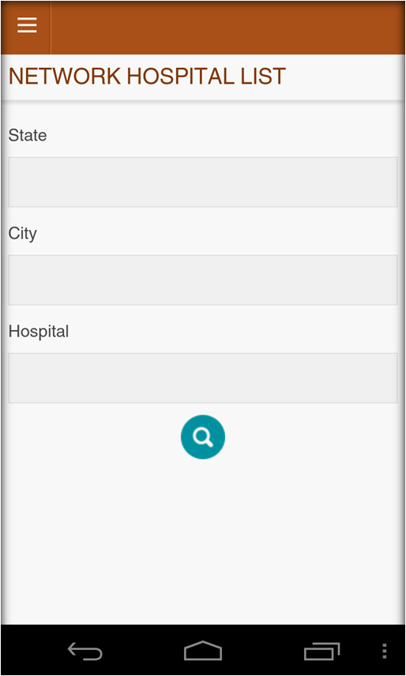
Broad Features - Mobile Sparrow
NETWORK HOSPITAL Screen 1
This functionality is used to Members who finds the FHPL Network Hospitals.
Member needs to enter below fields to find appropriate network hospitals. State & City are mandatory fields
State:
Member can type with initial characters of a specified State; then system auto populates with State information
City:
Member can type with initial characters of a specified City; then system auto populates with City information related to the selected State
Hospital:
Member can type with initial characters of a specified Hospital Name and hit Search button; system auto populates with the list of Hospital details

Slide 11
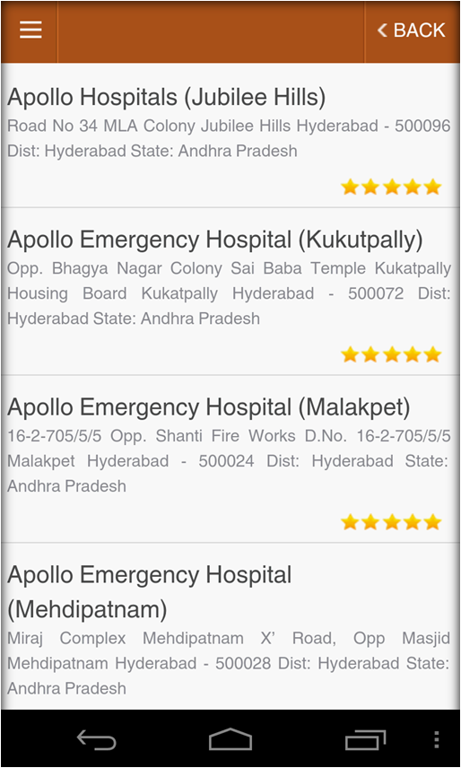
Broad Features - Mobile Sparrow
NETWORK HOSPITAL Screen 2
Hospital:
Based on the Hospital Search Criteria, the Hospital details are displayed on the screen as shown in the Screen.

Slide 12
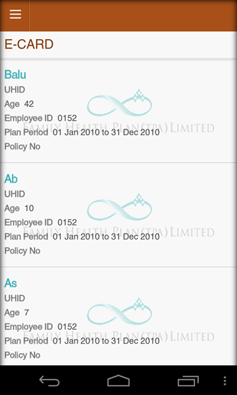
Broad Features - Mobile Sparrow
E-Card Screen
When a member clicks on E-CARD button, app displays the details of each member and immediate family.
The idea of E-CARD is to show the member level UHID to employee for any Hospitalization purpose

Slide 13
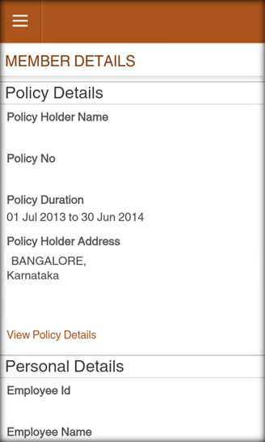
Broad Features - Mobile Sparrow
MEMBER DETAILS Screen 1
When a member clicks on MEMBER DETAILS link, application displays the basic Policy information like Policy Holder, Policy No., Policy duration & Holder Address.
“View Policy Details” link is provided to know the policy terms & conditions for any hospitalization claims.
Employee’s family relationships and respective member details are displayed

Slide 14
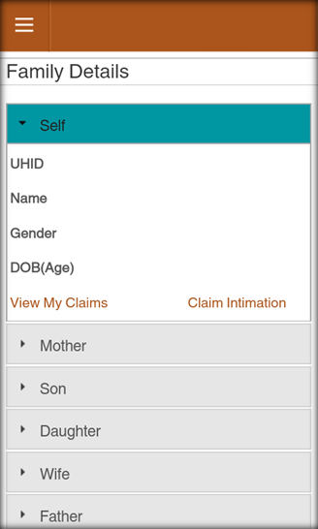
Broad Features - Mobile Sparrow
MEMBER DETAILS Screen 2
As part of MEMBER DETAILS feature, application displays the Employee’s family relationships and respective member details are displayed.
The details are:
UHID
Name
Gender
Date of Birth & Age
2 Links are provided to view respective member claims & Claim Intimation features.
“View My Claims” displays the list of total claims against the member and when each claim is selected, respective “Claim Details” page gets displayed as mentioned in the previous slides

Slide 15
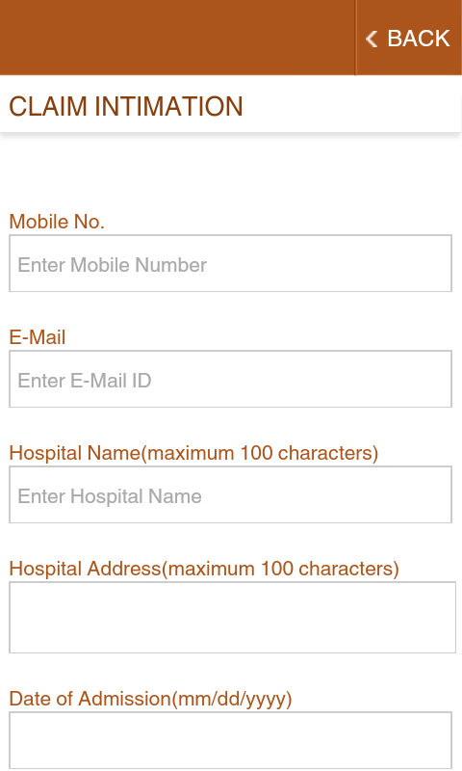
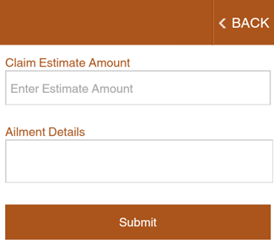
Broad Features - Mobile Sparrow
CLAIM INTIMATION Screen
Claim Intimation feature is used for a member who has planned hospitalization and provide the details to Intimate FHPL about the Hospitalization. System generates online Intimation ID and displays on the screen for future reference perspective.

Slide 16
FHPL Support
THANK YOU

